Slide 1

Leading Well
A Leadership Learning Intervention - STEP Student Leaders & the Relational Leadership Model

Slide 3

Why This Problem OF PRACTICE
Burnout is common among student leaders
Emotional labor and high expectations
Affects motivation, confidence, and belonging
Need for sustainable, people-centered leadership

Slide 4

Why the Relational Leadership Model (RLM)?
Focus on relationships and wellbeing
Supports inclusive, ethical, and empowering leadership
Helps leaders reconnect to purpose
Encourages healthy leadership habits

Slide 5

Purposeful: reconnect to why
Inclusive: reduce isolation, build community
Empowering: share workload, set boundaries
Ethical: self-care as responsibility
Process-oriented: reflect and adjust behaviors
RLM Elements That Address Burnout

Slide 6

Supports emotional well-being
Builds confidence and community
Encourages healthy boundaries
Offers practical strategies for sustained leadership
Why This Helps STEP Student Leaders

Slide 7
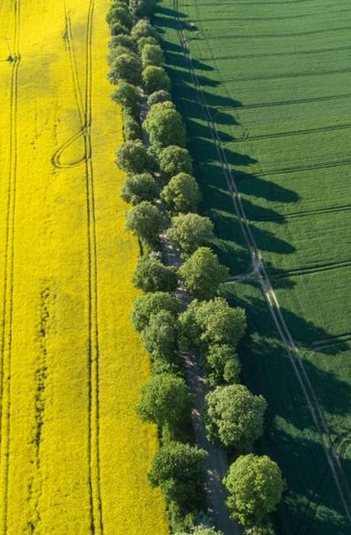
Learning Strategies &
Pedagogies
Experiential learning
Reflective dialogue
Collaborative learning
Storytelling and shared experiences

Slide 8
Session | Focus | Key Goals | Time
Session 1: Recognizing Burnout & Understanding Relational Leadership | Define burnout; explore RLM as a wellness framework | Identify personal stress signals; connect leadership and wellbeing | 90 min
Session 2: Empathy, Empowerment, and Boundaries in Leadership | Learn how inclusion and empowerment reduce burnout | Practice empathy and boundary-setting as tools for sustainability | 90 min
Session 3: Leading with Purpose and Process | Integrate RLM principles into daily leadership | Create a personal Relational Wellness Action Plan. | 90 min

Slide 9
Expected Impact
Stronger self-awareness
Improved balance and boundaries
More relational, sustainable leadership
Increased peer support and connection

Slide 10

Sustainability
Integrate the intervention into the existing STEP training cycle
Engage returning STEP leaders as co-facilitators
Implement mid-semester wellness check-ins and follow-ups

Slide 11
Thank you

